Slide 1

fcfs scheduling & lru page replacement algorithm
By: Sathkeerthi y Agnihothri & shyam prasad m

Slide 2
Overview of presentation
FCFS Scheduling algorithm
LRU page replacement algorithm
Project Members

Slide 3

First come, first serve [FCFS]
SCHEDULING ALGORITHM

Slide 4
Fcfs scheduling overview
What is FCFS?
Why is FCFS scheduling algorithm useful?
Some disadvantages of FCFS scheduling
FCFS implementation using C++
Output sample

Slide 5

First come, first serve [fcfs]
Simplest scheduling algorithm.
process that comes first will be executed first and next process starts only after the previous gets fully executed.

Slide 6

Why is FCFS scheduling algorithm useful?
Very simple, and they operate on the order of arrival time, no switching and complications.
Easy to implement into any system.
As calculating the algorithm for orders is so simple, it is easy for team members of any experience or skill level to manage order scheduling and write and understand code with ease, thus easy to implement.

Slide 7
Disadvantages of fcfs
Any process that has low execution time suffers, since waiting time is long.
Lower CPU and resource utilization, i.e not efficient.
Process with large burst time will keep the resources for long time, thus other processes will have to wait for long time unnecessarily (Convey Effect).
For time-sharing systems, it is essential that each user get a share of the CPU at regular intervals. Because FCFS is a non-preemptive system, this is not always feasible.

Slide 8
FCFS implementation using C++
#include <iostream>
#include <algorithm>
#include <iomanip>
using namespace std;
struct Schedule
{
string pro_id;
int artime,bt,ct,tat,wt;
// artime = Arrival time,
// bt = Burst time,
// ct = Completion time,
// tat = Turn around time,
// wt = Waiting time };

Slide 9
bool compare(Schedule p1,Schedule p2)
{
return p1.artime < p2.artime;
/* To sort the processes according to the order of their Arrival Times */
}
bool revind(Schedule p1,Schedule p2)
{
return p1.pro_id < p2.pro_id;
/* To revert back the processes in the order of process id */
}
int main()
{ Schedule process[100];
//An array of Processes int cpunon=0;
int n,i;
//n = number of processes, i= iteration variable float percentage;
cout << "------\nINPUT\n------" << flush;
cout << "\nEnter the number of processes: " << flush;
cin >> n; cout << "Enter the Process id, Arrival time and Burst time of the " << n << " processes :" << endl;

Slide 10
for(i=0;i<n;i++){
cin>>process[i].pro_id;
cin >> process[i].artime;
cin >> process[i].bt;
}
sort(process,process+n,compare);
/* Sort is a predefined function defined in algorithm.h header file,
it will sort the processes according to their arrival times */
cpunon=process[0].artime-0;
// initial values process[0].ct=process[0].artime+process[0].bt;
process[0].tat=process[0].ct-process[0].artime;
process[0].wt=0;
for(i=1;i<n;i++){
if(process[i].artime<=process[i-1].ct){
process[i].ct=process[i-1].ct+process[i].bt;
process[i].tat=process[i].ct-process[i].artime;
process[i].wt=process[i].tat-process[i].bt;
}
else {
process[i].ct=process[i].bt+process[i].artime;
process[i].tat=process[i].ct-process[i].artime;
process[i].wt=process[i].tat-process[i].bt;
cpunon+=process[i].artime-process[i-1].ct;
}
}

Slide 11
percentage=(float)((process[n-1].ct-cpunon)/process[n-1].ct)*100;
cout<< endl << "-------\nOUTPUT\n-------" << endl;
sort(process, process+n, revind);
cout << "\n\tP#\t AT\t BT\t CT\t TAT\t WT\t\n\n" ;
double total_tat = 0.0;
double total_wt = 0.0;
for(i=0;i<n;i++)
{
//keep all statements in one line
cout<<"\t"<<process[i].pro_id<< "\t"<<process[i].artime<<"\t"<<process[i].bt<<"\t"<<process[i].ct<<"\t"<<process[i].tat<<"\t "<<process[i].wt;
total_tat += process[i].tat;
total_wt += process[i].wt;
cout<<endl;
}
cout << fixed << setprecision(2)<< endl;
cout<<"Average Turn Around Time: "<<(total_tat/n)<<"\n";
cout<<"Average Waiting Time: "<<(total_wt/n)<<"\n";
return 0;
}

Slide 12
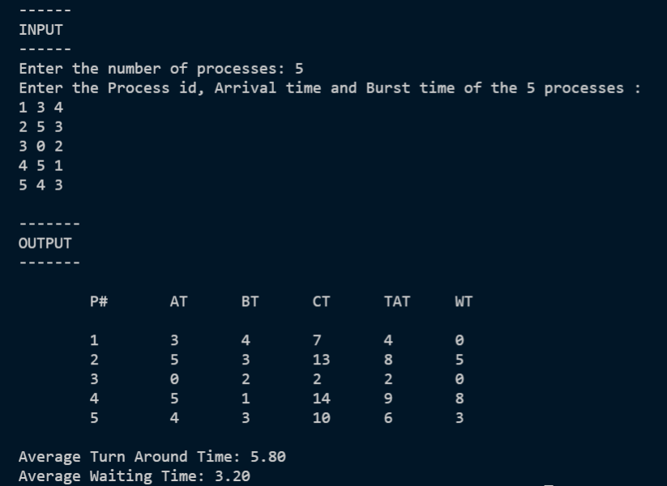
Sample output

Slide 13

LEAST RECENTLY USED [LRU]
PAGE REPLACEMENT ALGORITHM

Slide 14
LRU PAGE REPLACEMENT overview
What is LRU Page Replacement Algorithm?
Advantages of LRU
Disadvantages of LRU
LRU implementation using C++
Output sample

Slide 15

WHAT IS LRU PAGE REPLACEMENT ALGORITHM?
This algorithm stands for "Least Recently Used" and this algorithm helps the Operating system to search those pages that are used over a short duration of time frame.
It works on the concept that pages that have been highly used in the past are likely to be significantly used again in the future.
It removes the page that has not been utilized in the memory for the longest time.

Slide 16

Advantages of LRU
LRU doesn't suffer from Belady's Anomaly.
The page in the main memory that hasn't been used in the longest will be chosen for replacement.
It gives fewer page faults than any other page replacement algorithm. So, LRU is the most commonly utilized method.
It is a very effective algorithm.
It helps in the full analysis.

Slide 17
Disadvantages of LRU
LRU's weakness is that its performance tends to degenerate under many quite common reference patterns.
It isn't easy to implement because it requires hardware assistance.
It is expensive and more complex.
It needs an additional data structure.

Slide 18
implementation OF LRU PAGE REPLACEMENT ALGORITHM using C++
#include<iostream>
using namespace std;
int main()
{
int nopages, nofaults, page[20],i ,count=0;
cout<<"Enter the Number of pages :\t";
cin>> nopages;
cout<<"\nEnter the Reference String :\t";
for(i=0;i< nopages;i++)
{
cout<<"";
cin>>page[i];
}
cout<<"\nEnter the Number of frames:\t";
cin>> nofaults;

Slide 19
int frame[nofaults],fcount[nofaults];
for(i=0;i< nofaults;i++)
{
frame[i]=-1;
fcount[i]=0;
}
i=0;
while(i< nopages)
{
int j=0,flag=0;
while(j< nofaults)
{
if(page[i]==frame[j])
{
flag=1;
fcount[j]=i+1;
}
j++;
}
j=0;
cout<<"\n\t\n";
cout<<"\t"<<page[i]<<" ->";
if(flag==0){
int min=0,k=0;
while(k<nofaults-1) {
if(fcount[min]>fcount[k+1])
min=k+1;
k++;
}
frame[min]=page[i];
fcount[min]=i+1;
count++;
while(j< nofaults) {

Slide 20
cout<<"\t|"<<frame[j]<<"|";
j++;
}
} i++;
}
cout<<"\n\nNumber of Page Faults :"<<count;
cout<<"\n\nNumber of Hits :"<<nopages - count;
cout<<"\n";
return 0;
}

Slide 21
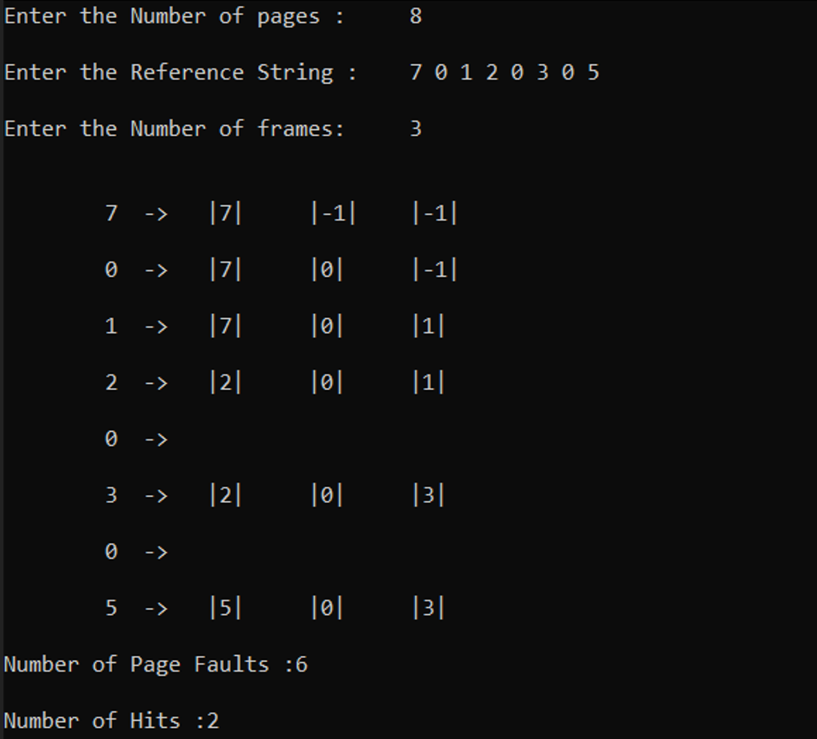
Output sample

Slide 22
PROJECT MEMBERS
Sathkeerthi Y Agnihothri 4NI19CS099
Shyam Prasad M 4NI19CS106

Slide 23

Thank You

